Slide 1
Final Year Project 2015/16
T00164481 Enda Brody Computing with game Design

Slide 2

My Proposal
A multiplayer First person shooter game that uses a database that stores a player info in which I will focus on security Testing my game and check if the gamer profile is secure and unhackable.

Slide 3
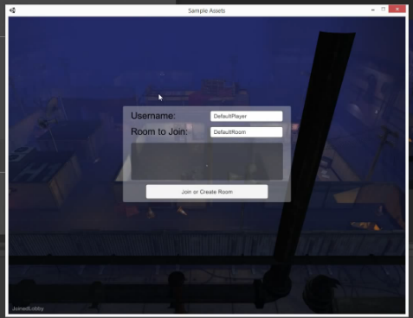
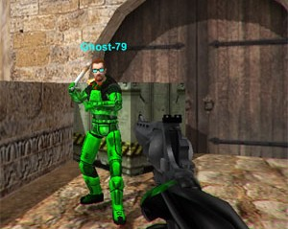
The Game
The game will be a multiplayer first person shooter in which players will fight each for experience and loot in which they will use to upgrade the game avatar.
The player will have a user name and password and other details stored on a database.
The player can also buy and trade items with other players and at an item store.
I will be testing my game for any possible hacks or breech of security so that no outside party or other player will be able to have access to another players account.

Slide 4
What will I need
Game
Unity C #
Networking Photon
Database
MySQL + php
Microsoft visual C#
Security Testing
Automated testing Soap UI
Hacking tutorial C++

Slide 5
Research Challenges
C++
Photon unity networking tool
Hacking
Security testing tools
Database Security

Slide 6
Videos & Books
https://www.youtube.com/watch?v=A_MrrAo8uLk
https://unity3d.com/learn/tutorials/modules/intermediate/live-training-archive/merry-fragmas-multiplayer-fps-3
https://www.youtube.com/user/Learn2Dev
https://www.youtube.com/watch?v=r1u_LzjOLpA
http://www.paladinstudios.com/2013/07/10/how-to-create-an-online-multiplayer-game-with-unity/
Computer security by William Stallings
Writing Secure Code by Michael Howard
Assessing Network Security by Kevin Lam

